Slide 1
MARKETING ANALYTICS I
SESSION 16:
PRICE AND ADVERTISING RESPONSE
Professor Sonnier
Texas MSBA Program
Fall 2022

Slide 2
MARKETING ANALYTICS
Monthly Prius Sales

Slide 3
MARKETING ANALYTICS
Value in Use
What Effect Do Gas Prices Have on Prius Sales?

Slide 4
MARKETING ANALYTICS
Value in Use
We have two models
Log-Log Model
Linear Model
Which model do we prefer?
Log-Log Model
Linear Model

Slide 5
MARKETING ANALYTICS
Value in Use
What Effect Do Gas Prices Have on Prius Sales?
Linear Regression
Marginal Effect of Gas Prices on Sales
Elasticity of Sales with respect to Gas Prices

Slide 6
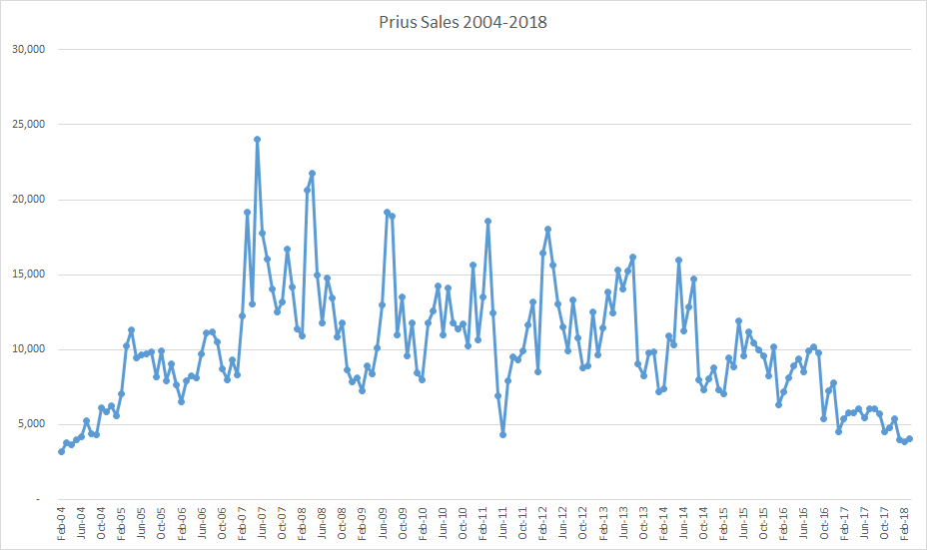
MARKETING ANALYTICS
Monthly Prius Sales: The Full Picture

Slide 7


MARKETING ANALYTICS
Value in Use
We have two models
Log-Log Model
Linear Model
Which model do we prefer?
Log-Log Model
Linear Model

Slide 8
MARKETING ANALYTICS
In the Long View…
What Effect Do Gas Prices Have on Prius Sales?
Sales and Price data through Spring 2018

Slide 9
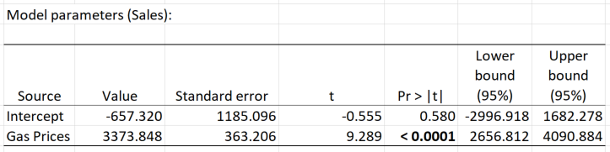
MARKETING ANALYTICS
In the Long View…
What Effect Do Gas Prices Have on Prius Sales?
Linear Regression
Marginal Effect of Gas Prices on Sales
Elasticity of Sales with respect to Gas Prices

Slide 10
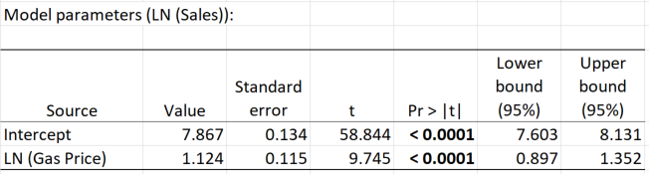
MARKETING ANALYTICS
In the Long View…
What Effect Do Gas Prices Have on Prius Sales?
Log Log Regression
Marginal Effect of Gas Prices on Sales
Elasticity of Sales with respect to Gas Prices

Slide 11
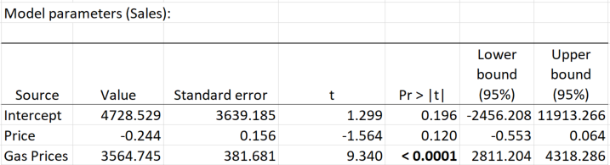
MARKETING ANALYTICS
Let’s Bring Price Into the Equation
Data through Spring 2018
Linear Model

Slide 12
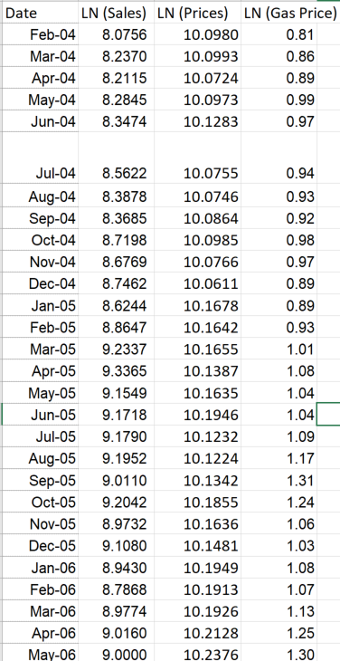
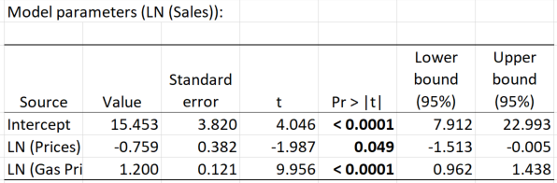
MARKETING ANALYTICS
Let’s Bring Price Into the Equation
Data through Spring 2018
Log Log Model
A 10% increase in price yields a 7.6% drop in sales
A 10% increase in gas price yields a 12% increase in sales

Slide 13
MARKETING ANALYTICS
Threat to Model Validity: Collinearity in X Variables
Gas Prices
Prices

Slide 14
MARKETING ANALYTICS
Response Models: Things That Can Go Wrong
My X variables are highly collinear
Data Generating Process
What if X1 and X2 were perfectly collinear?
This means X1=X2
I can only identify the sum of the beta coefficients!

Slide 15
MARKETING ANALYTICS
When is Collinearity a Problem?
Let me generate some X data from samples of different sizes and with different correlation coefficients
Combined with some randomly drawn error terms and beta coefficients, I can then create some y variables
I can then use OLS regression on this synthetic data to see if I can recover the beta coefficients used to generate the data
Let’s investigate this set up for different values of correlation as well as different sample sizes

Slide 16
MARKETING ANALTICS
Response Models: Things That Can Go Wrong
Some important X variable is omitted from my model and correlated with another X variable of interest
Data Generating Process
I don’t observe x₂
x₂ is important for y
x₂ is correlated with x₁

Slide 17
MARKETING ANALYTICS
When are Omitted Variables a Problem?
Data Generating Process
You Do Not Observe x²
Examples of unobserved X’s
Quality in a sales-price regression
Intellectual Ability in a wage-years of schooling regression

Slide 18
MARKETING ANALYTICS
Monthly Prius Sales: The Full Picture

Slide 19
MARKETING ANALYTICS
Two Types of Controls for Dynamic Omitted Variables
Seasonal Fixed Effects
Time Trends

Slide 20
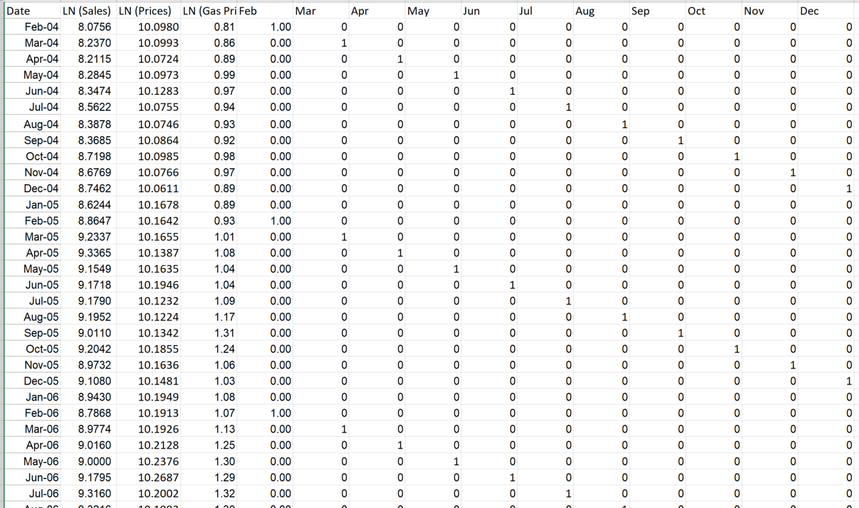
MARKETING ANALYTICS
Monthly Seasonality

Slide 21
MARKETING ANALYTICS
Flexibly Capturing Trend
Y=b1*x1+b2*(LN(x1))
x2=LN(x1)
x2=LN(x1)

Slide 22
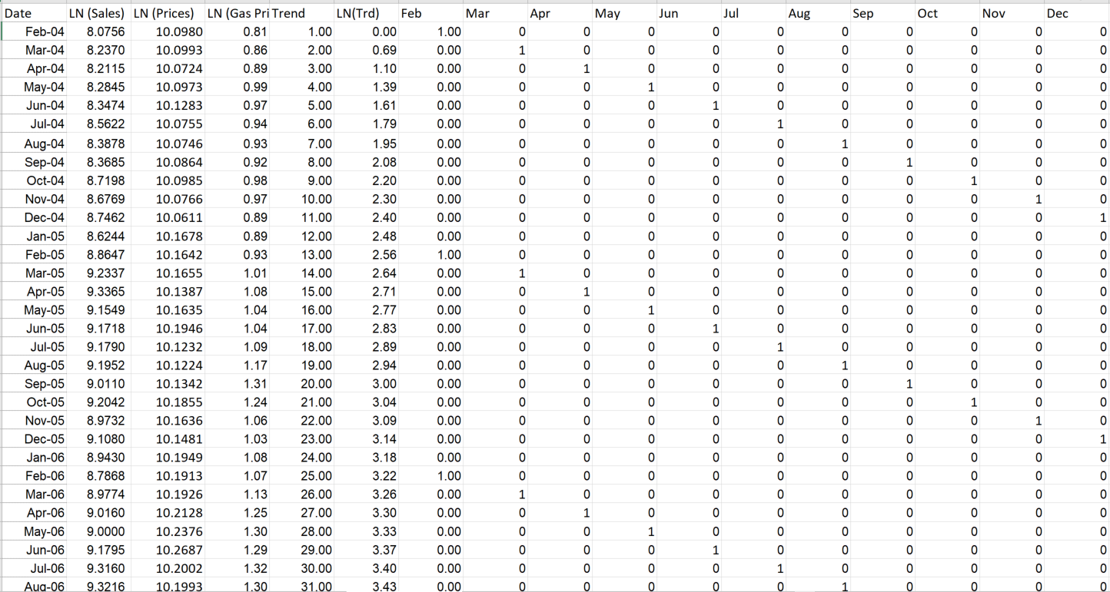
MARKETING ANALYTICS
Monthly Prius Sales: Prices, Gas Prices, Trend and Seasonal Effects

Slide 23
MARKETING ANALYTICS
Model without Seasonality and Trend
A 10% increase in price yields a 7.6% drop in sales
A 10% increase in gas price yields a 12% increase in sales

Slide 24
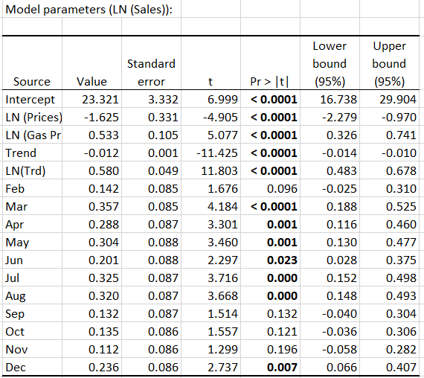
MARKETING ANALYTICS
Monthly Prius Sales: Prices, Gas Prices, Trend, Seasonal Effects
A 10% increase in price yields a 16.3% drop in sales
A 10% increase in gas price yields a 5.3% increase in sales
Now consider the idea that sales effects carry over from month to month
Use previous month sales as an X variable

Slide 25
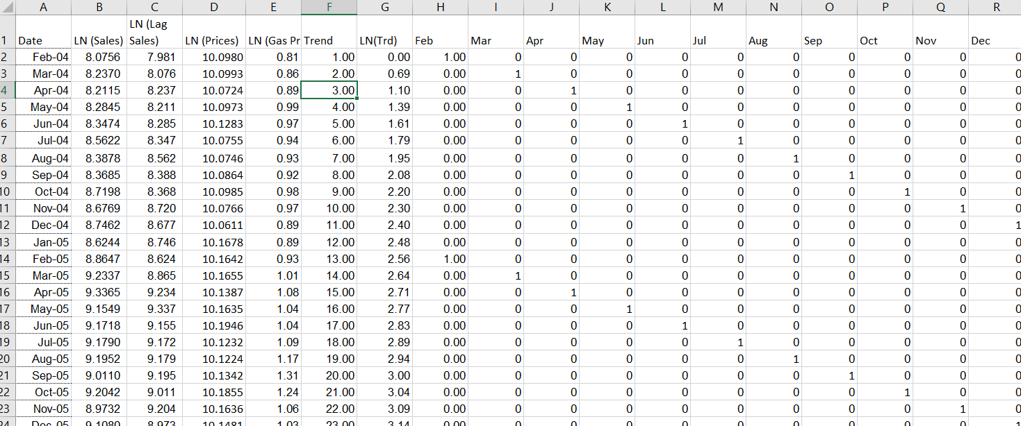
MARKETING ANALYTICS
The Effect of Current Period Gas and Price Shocks

Slide 26
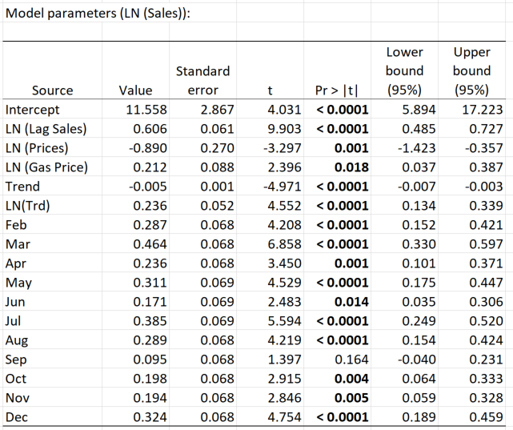
MARKETING ANALYTICS
Monthly Prius Sales: Prices, Gas Prices, Trend, Seasonal and Lag Sales Effects
A 10% increase in price yields an 8.9% drop in sales
A 10% increase in gas price yields a 2.1% increase in sales

Slide 27
MARKETING ANALYTICS
The Effect of Current Period Gas and Price Shocks
Shocks to price and gas price today have effects tomorrow (and beyond…)

Slide 28
MARKETING ANALYTICS
The Effect of Gas Prices
Effect of 10% Increase in Gas Price on Sales…
This Month: 2.12%
Next Month: 0.606*2.12%=1.28%
Two Months from Now: 0.606^2*2.12%=0.78%
T Months from Now: 0.606^T*2.12

Slide 29
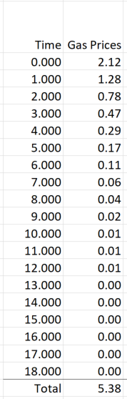
MARKETING ANALYTICS
Dynamic Effects: Gas Prices

Slide 30
MARKETING ANALYTICS
The Effect of Prices
Effect of 10% Increase in Price on Sales…
This Month: -8.9%
Next Month: 0.606*-8.9%=-5.40%
Two Months from Now: 0.606^2*-8.9%=-3.27%
T Months from Now: 0.606^T*-8.9%

Slide 31
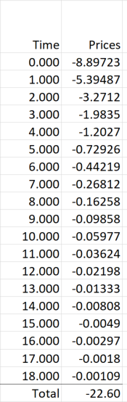
MARKETING ANALYTICS
Dynamic Effect: Prius Prices

Slide 32
MARKETING ANALYTICS
The Effect of Gas Prices
Effect of 10% Increase in Gas Price on Sales…
This Month: 2.12%
Next Month: 0.606*2.12%=1.28%
Two Months from Now: 0.606^2*2.12%=0.78%
T Months from Now: 0.606^T*2.12
Total Long Run Elasticity: 2.12%/(1-0.606)=5.38%

Slide 33
MARKETING ANALYTICS
The Effect of Prices
Effect of 10% Increase in Price on Sales…
This Month: -8.9%
Next Month: 0.606*-8.9%=-5.40%
Two Months from Now: 0.606^2*-8.9%=-3.27%
T Months from Now: 0.606^T*-8.9%
Total Long Run Elasticity: -8.9%/(1-0.606)=-22.60%

Slide 34
MARKETING ANALYTICS
U.S. Advertising Spending

Slide 35
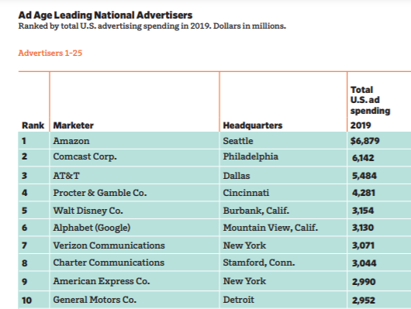
MARKETING ANALYTICS
Advertising: Which Firms Spend the Most?

Slide 36
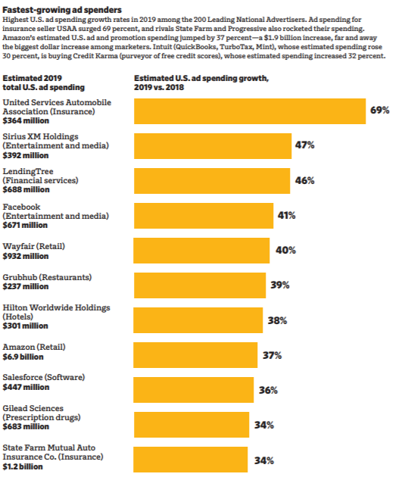
ADVERTISING
Which Firms Spend the Most?

Slide 37
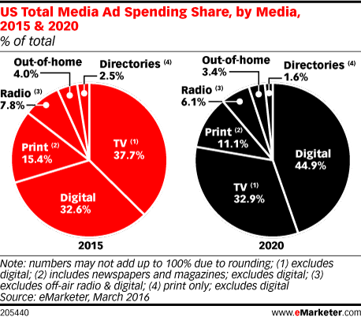
MARKETING ANALYTICS
U.S. Ad Spending by Media
TV expected to continue to play a major role
Digital will match or exceed TV spend in the near future
Print in decline

Slide 38
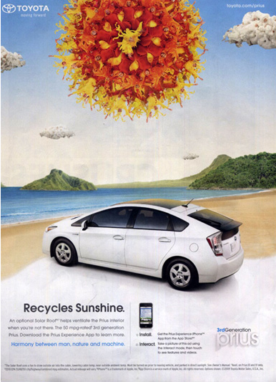
MARKETING ANALYTICS
Experiential Value

Slide 39
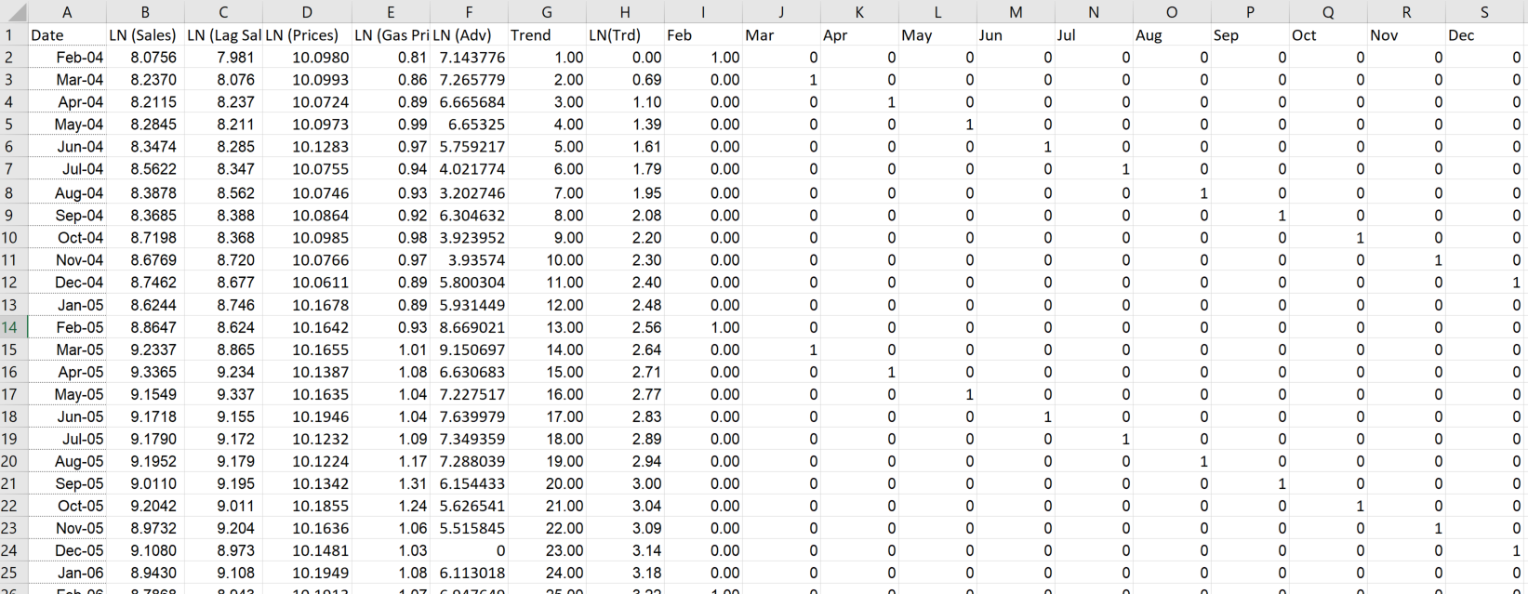
MARKETING ANALYTICS
Does Advertising Matter?
LN (Adv) is the natural log of ad spend measured in $1,000’s
So $1,600,000 is coded as $1,600 and LN(1,600) enters the data matrix
Increase of a 1,000 units would be a $1MM increase in ad spend

Slide 40
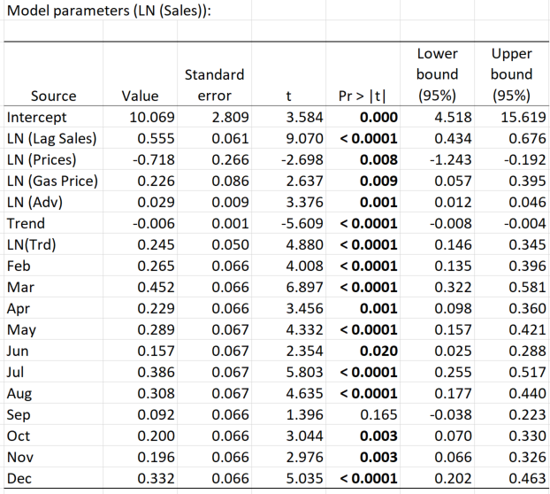
MARKETING ANALYTICS
Does Advertising Matter?

Slide 41
MARKETING ANALYTICS
Does Advertising Matter?
In the short run…
A 10% increase in price yields a 7.18% drop in sales
A 10% increase in gas price yields a 2.26% increase in sales
A 10% increase in ad spend yields a 0.29% increase in sales

Slide 42
MARKETING ANALYTICS
Does Advertising Matter?
In the long run…
A 10% increase in price yields a 16.2%drop in sales
A 10% increase in gas price yields a 5.08% increase in sales
A 10% increase in ad spend yields a 0.66% increase in sales

Slide 43
MARKETING ANALYTICS
Does Advertising Matter?

Slide 44
MARKETING ANALYTICS
Does Advertising Matter? A Closer Look
The elasticity of sales with respect to advertising
What about the effect of a unit change in ad spending on sales?

Slide 45
MARKETING ANALYTICS
Does Advertising Matter?
Does Advertising Matter? A Closer Look
The effect of a $ increase in sales on advertising
Advertising has a nonlinear effect on sales
Increases in ad spending have a stronger effect when the baseline level of sales is higher
Increases in ad spending have a stronger effect when the baseline level of advertising is lower

Slide 46
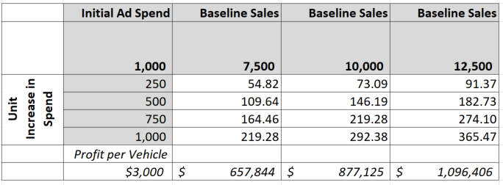
MARKETING ANALYTICS
Does Advertising Matter? A Closer Look
Advertising has a nonlinear effect on sales
Increases in ad spending have a stronger effect when the baseline level of sales is higher
Increases in ad spending have a stronger effect when the baseline level of advertising is lower
Notes: Profits calculated for Unit Increase in Spend of 1,000

Slide 47
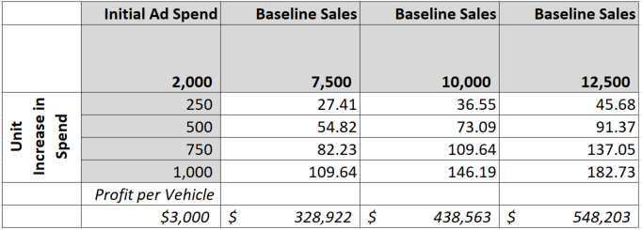
MARKETING ANALYTICS
Does Advertising Matter? A Closer Look
Advertising has a nonlinear effect on sales
Increases in ad spending have a stronger effect when the baseline level of sales is higher
Increases in ad spending have a stronger effect when the baseline level of advertising is lower
Notes: Profits calculated for Unit Increase in Spend of 1,000

Slide 48
ADVERTISING
The Importance of Accounting for Long Term Effects
Immediate Impact of Increased Ad Spend

Slide 49
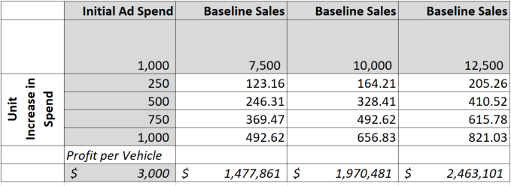
ADVERTISING
The Importance of Accounting for Long Term Effects
Long Run Impact of Increased Ad Spend

Slide 50
MARKETING ANALYTICS
The Decision Making Process and Advertising
NEEDS TRIGGER
INFORMATION SEARCH
INFORMATION PROCESSING AND EVALUATION
PURCHASE DECISION
POST PURCHASE EVALUATION

Slide 51
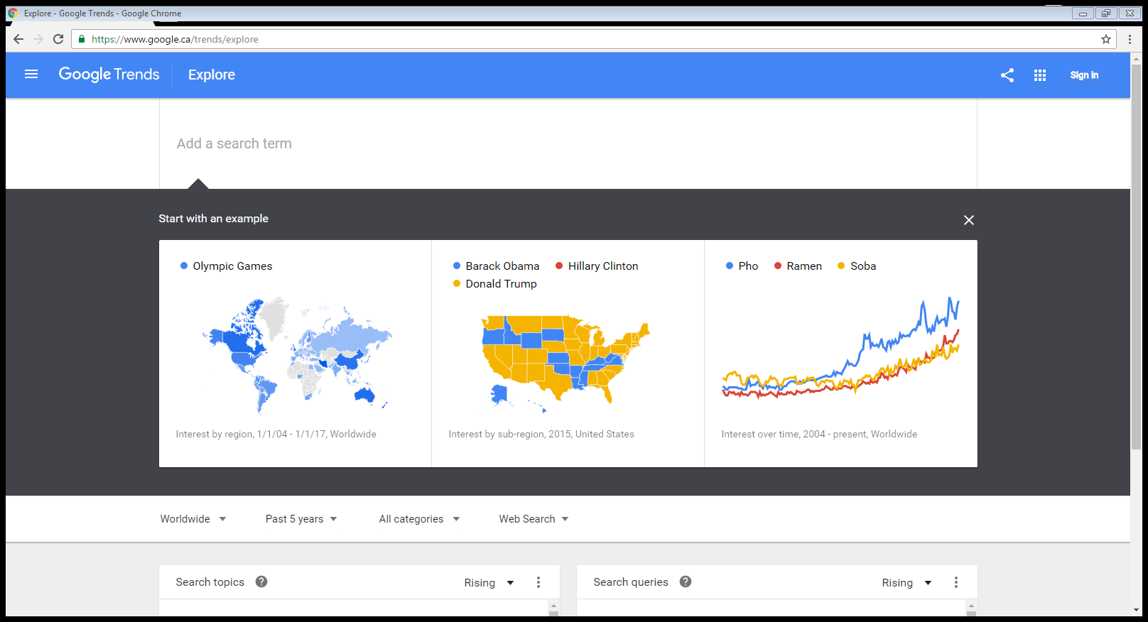

MARKETING ANALYTICS
Understanding Search and Awareness

Slide 52
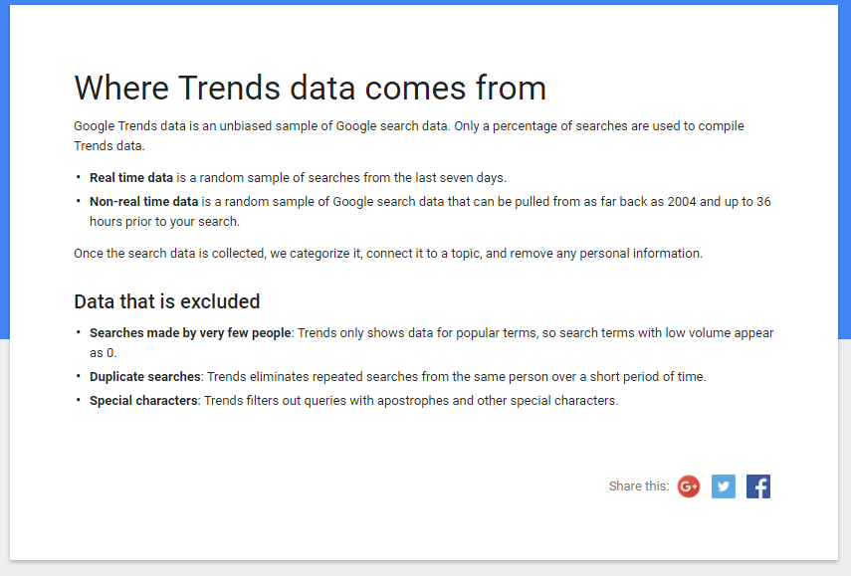
MARKETING ANALYTICS
Google Trends Data

Slide 53
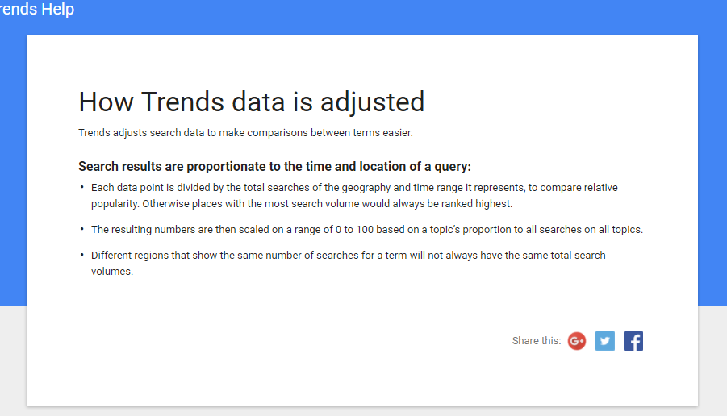
MARKETING ANALYTICS
Google Trends Data

Slide 54
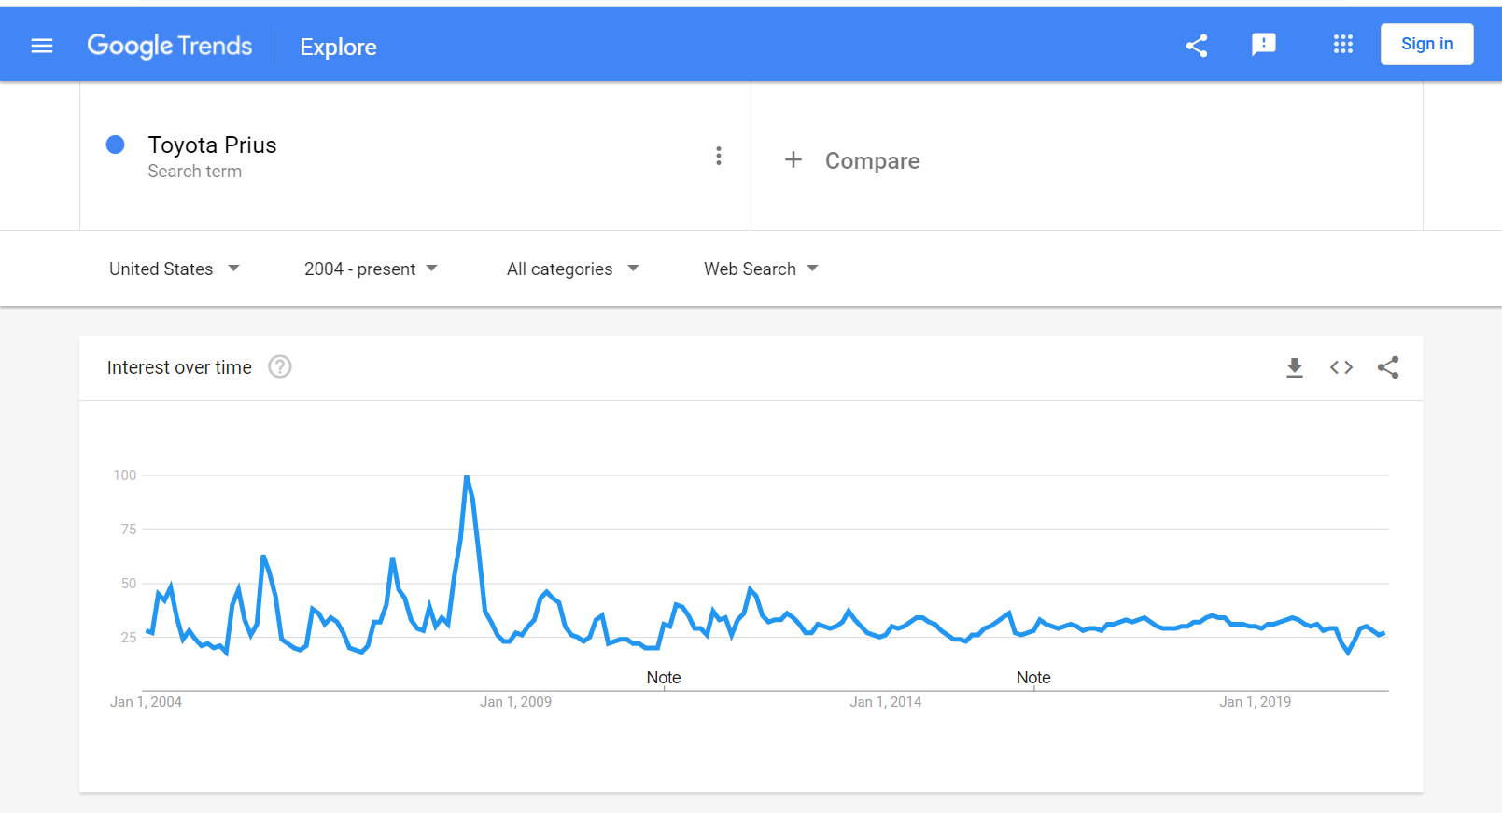
MARKETING ANALYTICS
Google Trends Data

Slide 55
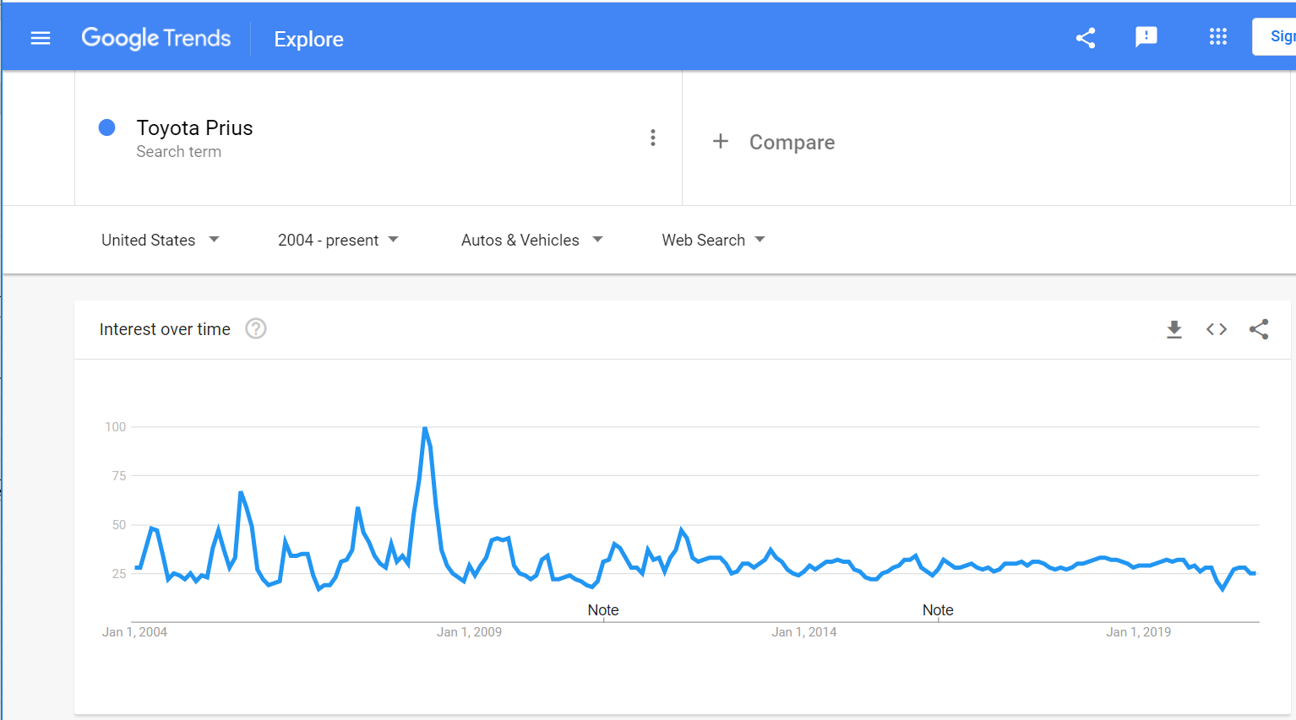
MARKETING ANALYTICS
Google Trends Data

Slide 56
CONSUMER BEHAVIOR
The Decision Making Process
NEEDS TRIGGER
INFORMATION SEARCH
We can use data on search to build a stylized empirical model of the decision making process
INFORMATION PROCESSING AND EVALUATION
We would like to know if advertising is affecting sales via information or persuasion
PURCHASE DECISION
POST PURCHASE EVALUATION

Slide 57
CONSUMER BEHAVIOR
Understanding Search and Awareness

Slide 58
CONSUMER BEHAVIOR
A Stylized Model of Information Search
GAS PRICES
INFORMATION SEARCH
AD SPENDING

Slide 59
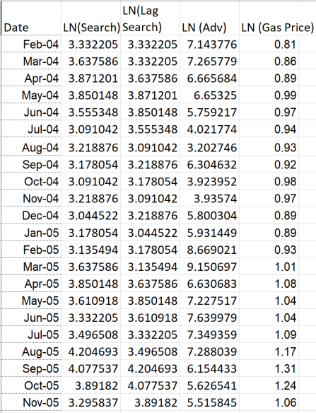
CONSUMER BEHAVIOR
A Stylized Model of Information Search
What about other variables?

Slide 60
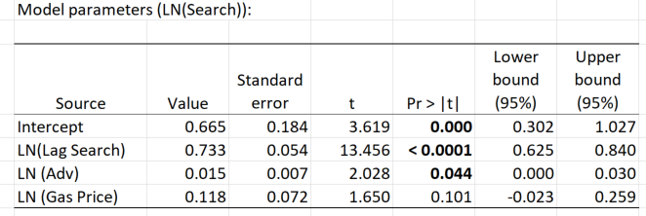
CONSUMER BEHAVIOR
Understanding Search and Awareness
SEARCH AS A FUNCTION OF AD SPEND AND GAS PRICES

Slide 61


CONSUMER BEHAVIOR
A Stylized Model of Information Search
GAS PRICES
INFORMATION SEARCH
AD SPENDING

Slide 62
MARKETING ANALYTICS
Monthly Prius Sales: The Full Picture
Does search impact sales?

Slide 63
CONSUMER BEHAVIOR
A Stylized Model of Prius Sales
GAS PRICES
INFORMATION SEARCH
AD SPENDING
PRIUS SALES

Slide 64
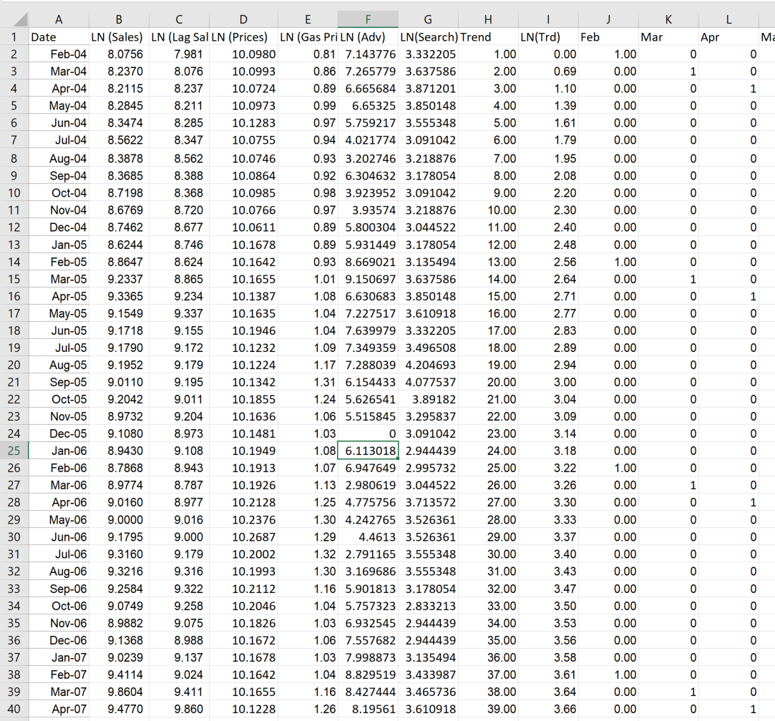
CONSUMER BEHAVIOR
A Stylized Model of Prius Sales

Slide 65
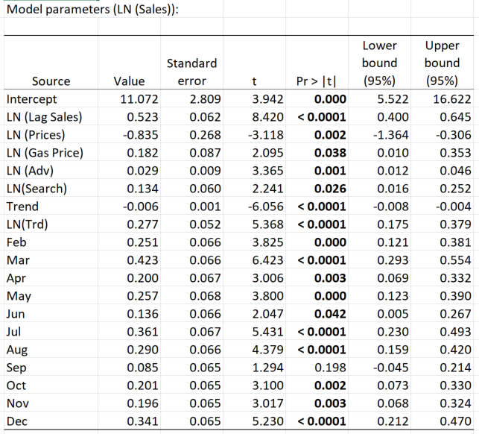
CONSUMER BEHAVIOR
Understanding Search and Awareness

Slide 66
CONSUMER BEHAVIOR
A Stylized Model of Prius Sales
GAS PRICES
INFORMATION SEARCH
AD SPENDING
PRIUS SALES
Advertising spending has an informative and a persuasive effect on sales
Increases in ad spend drive information search which, in turn, drives sales (informative effect)
Increases in ad spend have a direct effect on sales (persuasive effect)
Gas prices have only a direct effect on sales
Increases in gas prices do not affect information search
Gas prices have a direct effect on sales

Slide 67
CONSUMER BEHAVIOR
Understanding Search, Ad Spend and Sales: A 100% Increase in Ad Spend
A 100% increase in Ad Spend results in a 1.5% increase in Search
What Impact does this have on Sales?

Slide 68
CONSUMER BEHAVIOR
Understanding Search, Ad Spend and Sales: A 100% Increase in Ad Spend
A 100% increase in Ad Spend results in a 1.5% increase in Search
What Impact does this have on Sales?
A 1.5% increase in Search generates a 1.5 x 0.134 = 0.201% increase in sales
What direct impact does a 100% increase in Ad Spend have on sales?
100 x 0.029 = 2.88%
Total effect of doubling ad spend is 3.078% with majority due to direct effect

Slide 69
MARKETING ANALYTICS
Models for Price and Ad Response
Linear and Log Log Models
Log-Log Models directly give us elasticities
Assess model fit
Assess implications for marginal effects
Important to control for other factors
Importance of long run effects for advertising ROI
Decomposing ad effects into direct and indirect effects

